Slide 1





Technology
Assessment
Our Team
Vraj Deriya
Riyazul Ansari
Sai Kiran Billa
Yvonne Yang
Mihika Bodke
1

Slide 2

Table
of Contents
Purpose and scope
Benchmark and current state
Opportunity areas by function
Risks and constraints
Roadmap and next steps
Conclusion
2

Slide 3



Introduction
Purpose:
To assess how AI and digital technologies can enhance Walmart’s customer experience and operational performance.
Despite significant investments in analytics and automation, Walmart’s AI adoption remains fragmented and primarily focused on efficiency rather than customer experience.
This assessment connects insights from the competitive and user analyses to define a clear, scalable technology roadmap for greater impact and integration.
3

Slide 4

Current StaTe and Challenges
AI is used across inventory and forecasting but less in personalized shopping journeys.
Customer experience remains transactional, with limited emotional connection or customized engagement.
Data is siloed between stores, e-commerce, and the app, limiting a unified customer view.
Employee skill gaps and cultural resistance slow adoption of advanced AI tools.
4

Slide 5
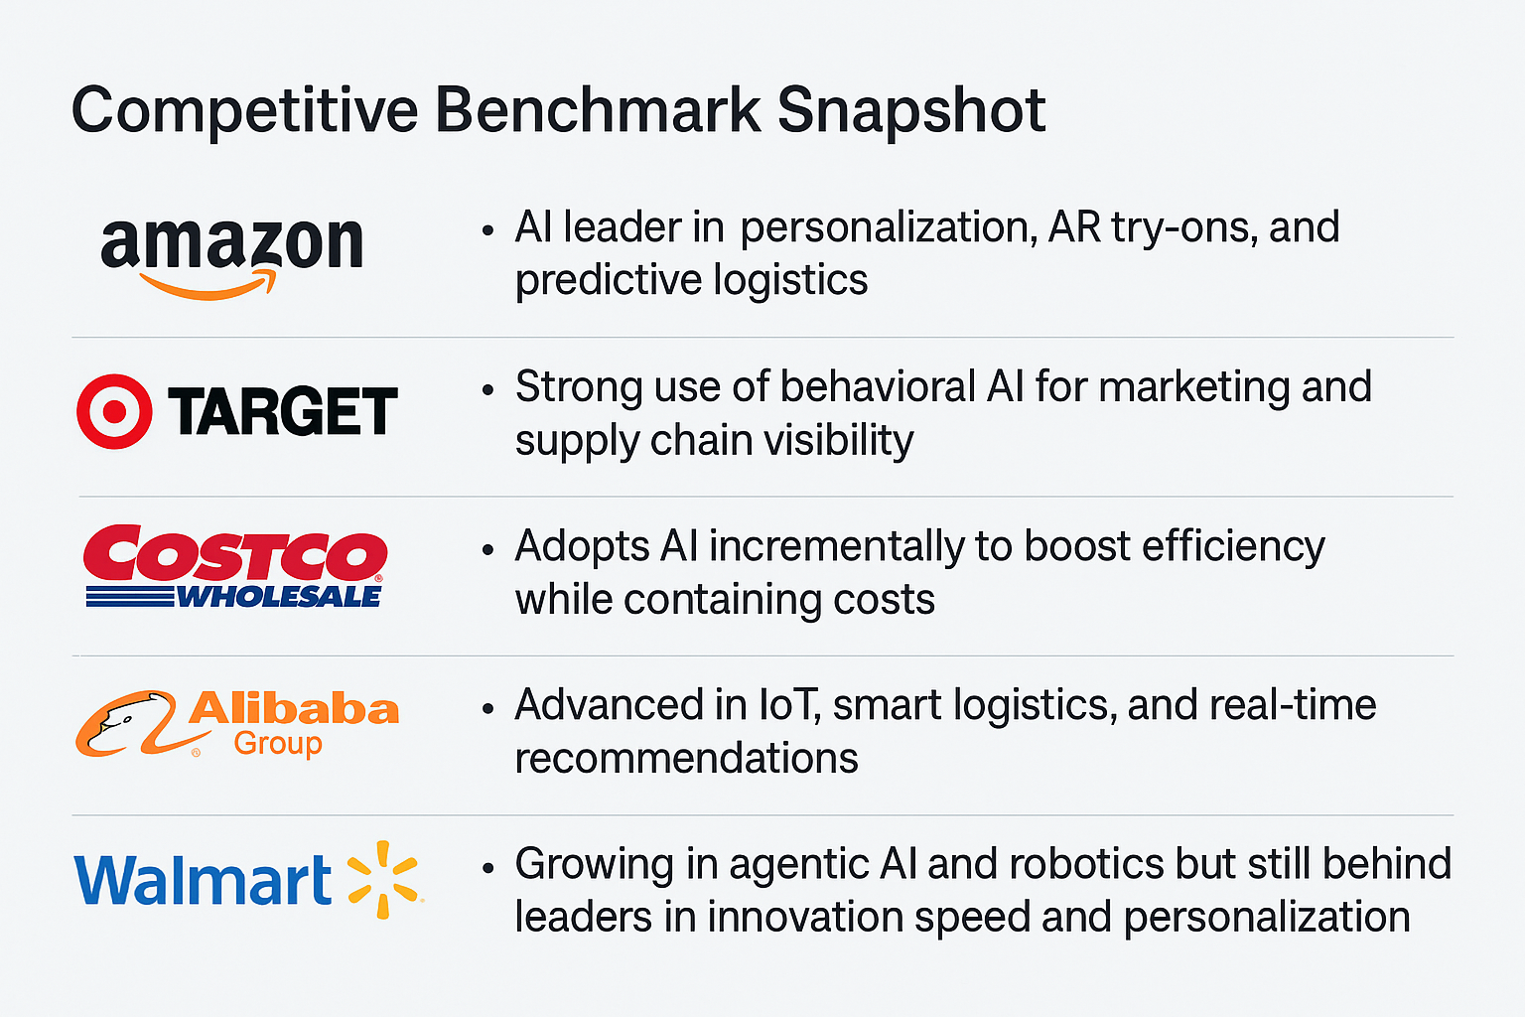
Competitive Benchmark
5

Slide 6

Innovation gaps
Minimal presence in AR and VR shopping experiences that drive digital engagement.
Limited adoption of generative AI for dynamic content creation and conversational commerce.
Predictive analytics remain less real-time and adaptive compared to competitors.
Robotics and automation programs exist but operate at a smaller scale across the network.
6

Slide 7
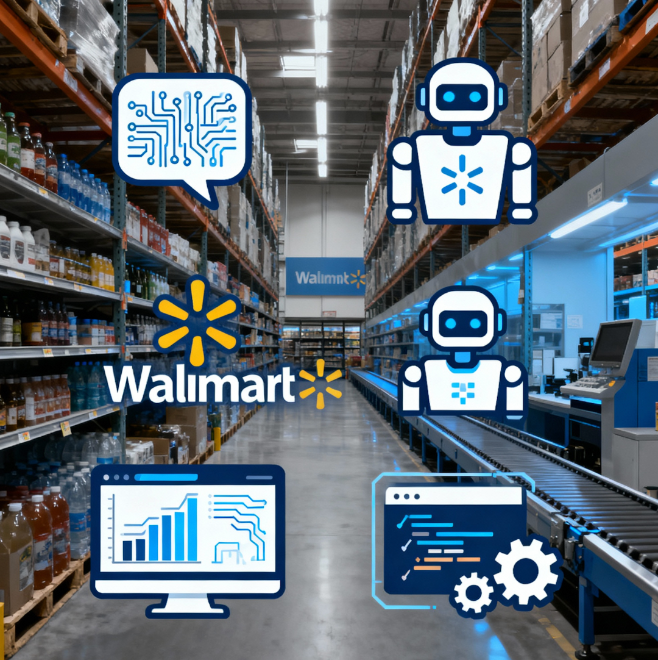
Emerging Technologies Shaping Retail
Agentic AI: Autonomous systems that perform inventory management and customer support tasks.
Generative AI: Powers personalized marketing, product search content, and conversational chat responses.
AR and VR: Enable virtual storefronts and interactive product try-ons that build customer confidence.
Computer Vision and IoT: Provide real-time shelf tracking, automated restocking, and smart loss prevention.
Digital Twins: Simulate store layouts and supply chains to improve forecasting, planning, and efficiency.
7

Slide 8
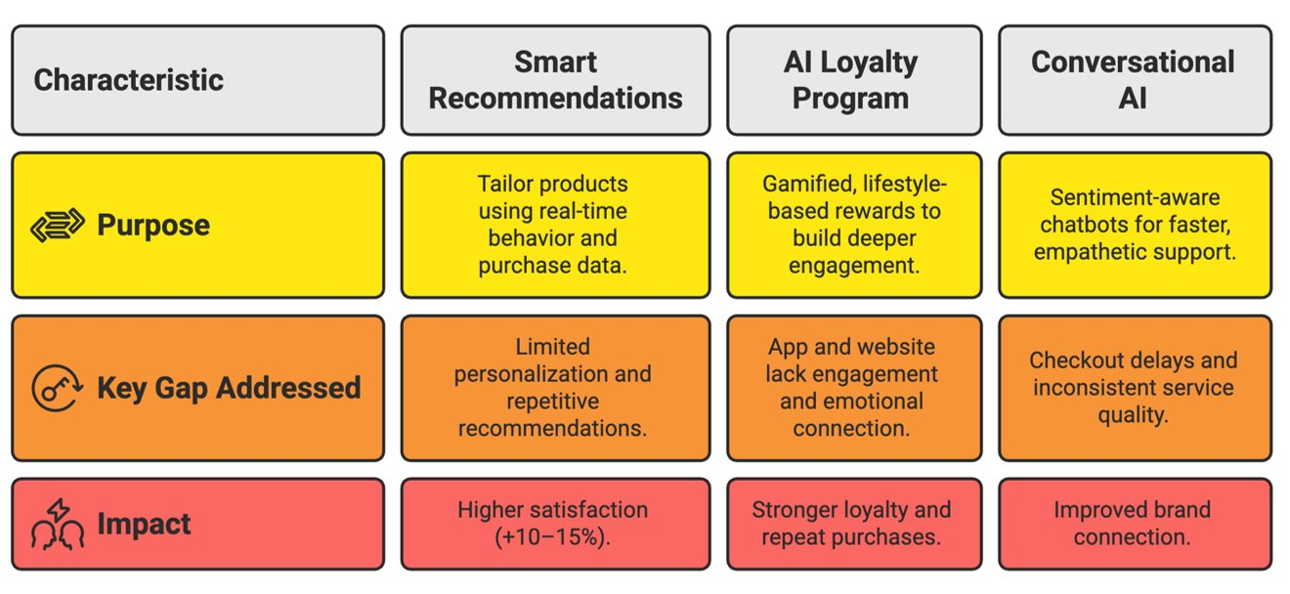
AI enhances satisfaction through predictive engagement and loyalty programs
8

Slide 9
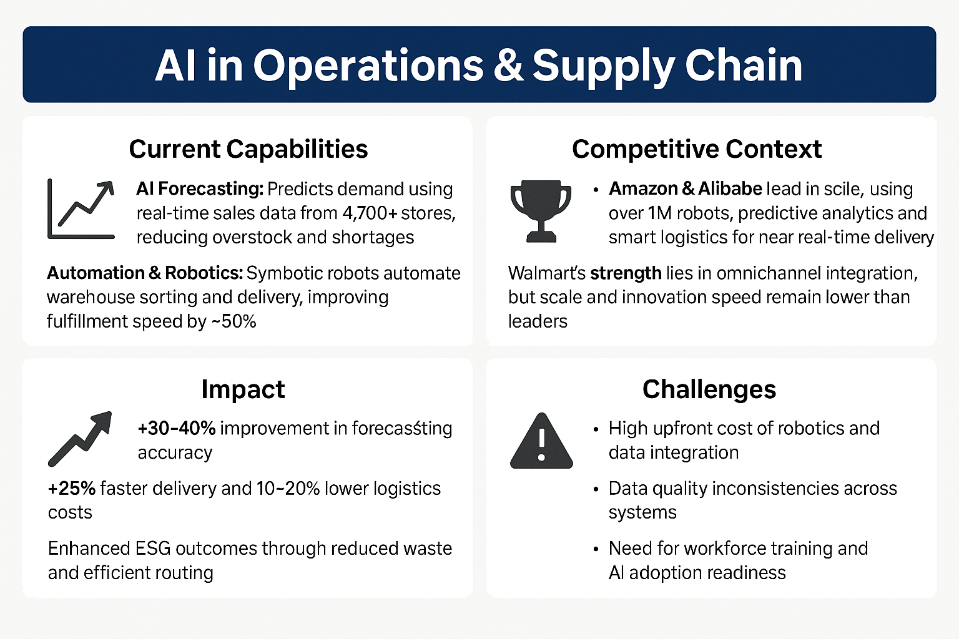
AI Operations in Supply Chain
9

Slide 10
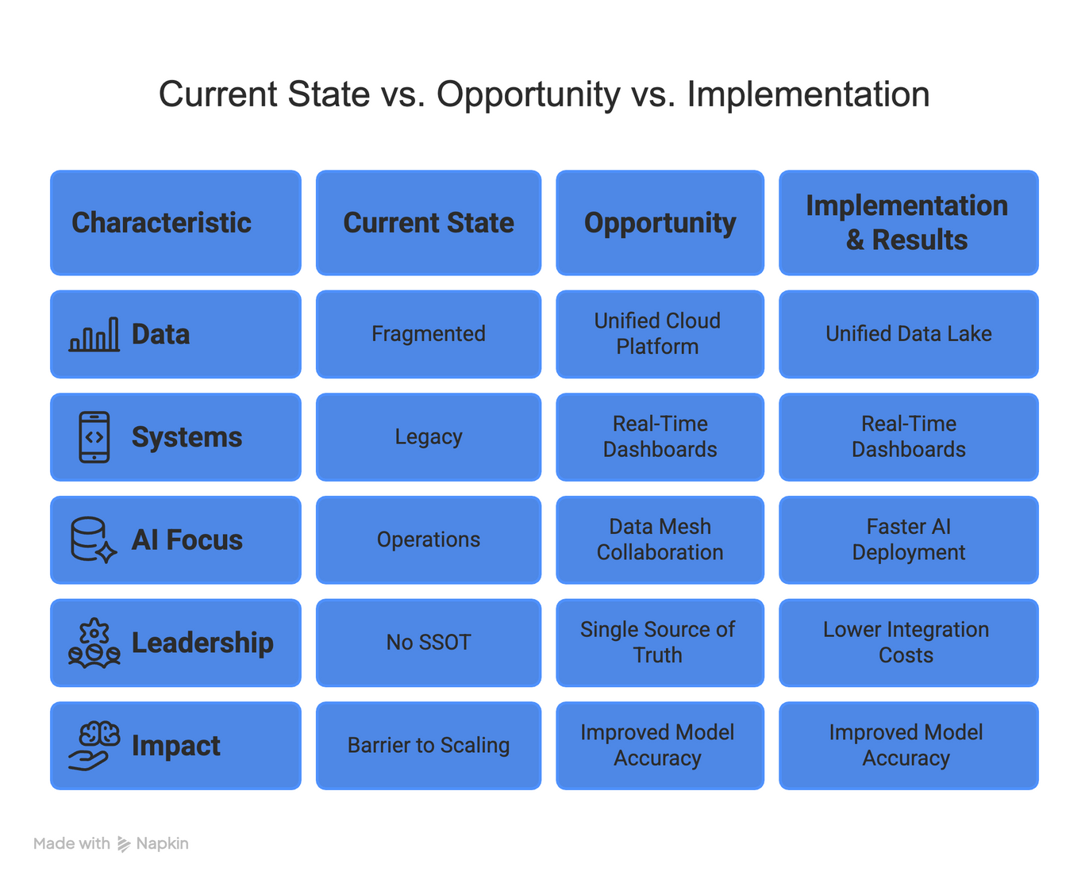
Data Infrastructure for Scalable AI
10

Slide 11
future innovation
Invest in Generative AI to enhance marketing, personalized content, and chat-based shopping support.
Develop AR & VR Experiences that bridge physical and digital retail to boost customer engagement.
Scale Robotics & IoT to improve fulfillment speed, inventory accuracy, and workforce productivity.
Adopt Digital Twin Simulations for smarter forecasting, scenario planning, and risk mitigation.
Embed Responsible AI Frameworks to ensure fairness, transparency, and regulatory compliance.
11

Slide 12

Conclusion
Walmart is well-positioned to leverage AI to close the gap in personalization, speed, and customer engagement.
Building a unified data foundation and scaling AI across operations will enable efficiency, agility, and better decision-making.
Shifting from operational AI to customer-centric AI will strengthen satisfaction, loyalty, and long-term brand trust.
Competitive benchmarking reveals key opportunities in generative AI, AR/VR retail, and advanced predictive analytics.
A structured and responsible AI strategy ensures Walmart’s transformation remains sustainable, ethical, and innovation-driven.
12

Slide 13

Thank You
13

